Slide 1
Fundamentals of
Electric Circuits
2020.6
Chapter13
Magnetically Coupled Circuits

Slide 2
Chapter13 Magnetically Coupled Circuits
13.1 Introduction
13.2 Mutual Inductance
13.3 Energy in a Coupled Circuit
13.4 Linear Transformers
13.5 Ideal Transformers
13.6 Ideal Autotransformers

Slide 3
13.1 Introduction
The circuits we have considered so far may be regarded as conductively coupled, because one loop affects the neighboring loop through current conduction.
When two loops with or without contacts between them affect each other through the magnetic field generated by one of them, they are said to be magnetically coupled.

Slide 4
13.1 Introduction
The transformer is an electrical device designed on the basis of the concept of magnetic coupling. It uses magnetically coupled coils to transfer energy from one circuit to another. Transformers are key circuit elements.
They are used in power systems for stepping up or stepping down ac voltages or currents. They are used in electronic circuits such as radio and television receivers for such purposes as impedance matching, isolating one part of a circuit from another, and again for stepping up or down ac voltages and currents.

Slide 5


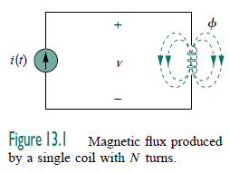


13.2 Mutual Inductance
When two inductors (or coils) are in a close proximity to each other, the magnetic flux caused by current in one coil links with the other coil, thereby inducing voltage in the latter. This phenomenon is known as mutual inductance.

Slide 6
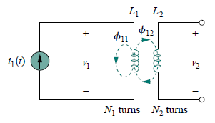






10.2 Mutual Inductance
For the sake of simplicity, assume that the second inductor carries no current. The magnetic flux φ₁ emanating from coil 1 has two components: one component φ₁₁ links only coil 1, and another component φ₁₂ links both coils. Hence, φ1 = φ11 + φ12
Although the two coils are physically separated, they are said to be magnetically coupled. Since the entire flux φ₁ links coil 1, the voltage induced in coil 1 is
M21 is known as the mutual inductance of coil 2 with respect to coil 1.

Slide 7
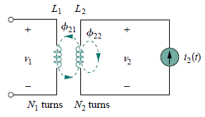





10.2 Mutual Inductance
Suppose we now let current i2 flow in coil 2, while coil 1 carries no current . The magnetic flux φ2 emanating from coil 2 comprises flux φ22 that links only coil 2 and flux φ21 that links both coils. Hence, φ2 = φ21 + φ22
which is the mutual inductance of coil 1 with respect to coil 2.

Slide 8
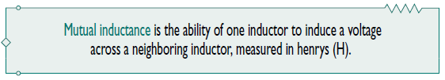
Although mutual inductance M is always a positive quantity, the mutual voltage M di/dt may be negative or positive, just like the self induced voltage Ldi/dt.
However, unlike the self-induced Ldi/dt, whose polarity is determined by the reference direction of the current and the reference polarity of the voltage (according to the passive sign convention), the polarity of mutual voltage M di/dt is not easy to determine, because four terminals are involved.

Slide 9
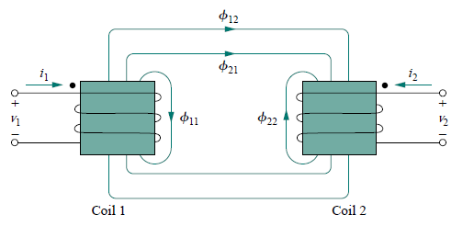
The choice of the correct polarity for M di/dt is made by examining the orientation or particular way in which both coils are physically wound and applying Lenz’s law in conjunction with the right-hand rule.
Since it is inconvenient to show the construction details of coils on a circuit schematic, we apply the dot convention in circuit analysis.
By this convention, a dot is placed in the circuit at one end of each of the two magnetically coupled coils to indicate the direction of the magnetic flux if current enters that dotted terminal of the coil.

Slide 10
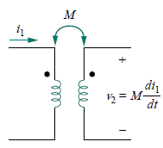
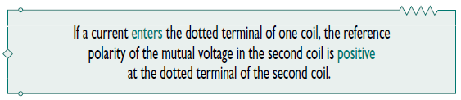
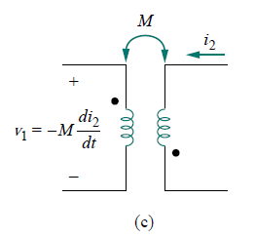
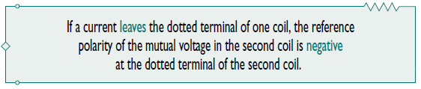

Slide 11
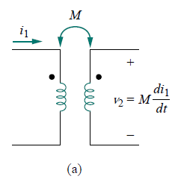
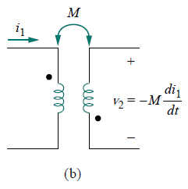
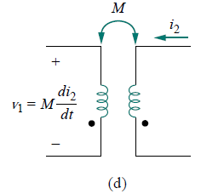

Slide 12
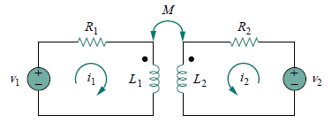


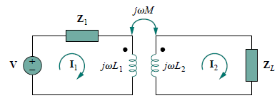



Slide 13
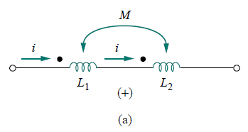

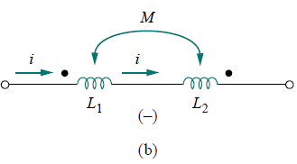


Slide 14

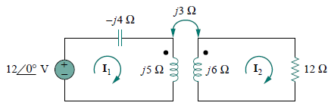







Slide 15

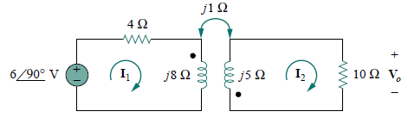

Slide 16

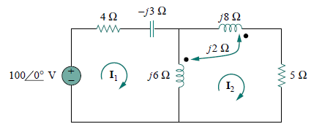







Slide 17
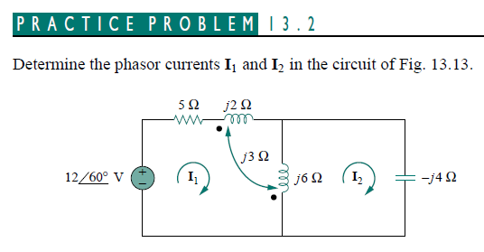


Slide 18

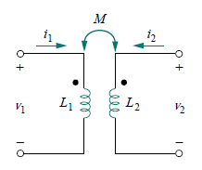

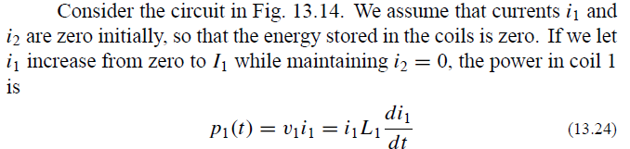
10.3 ENERGY IN A COUPLED CIRCUIT
In Chapter 6, we saw that the energy stored in an inductor is given by
We now want to determine the energy stored in magnetically coupled coils.

Slide 19


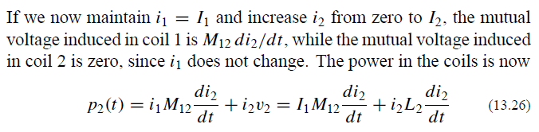






Slide 20





The positive sign is selected for the mutual term if both currents enter or leave the dotted terminals of the coils; the negative sign is selected otherwise.
Coefficient of coupling k
where 0 ≤ k ≤ 1
The coupling coefficient is the fraction of the total flux emanating from one coil that links the other coil.

Slide 21
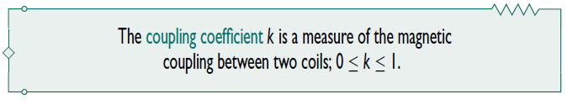
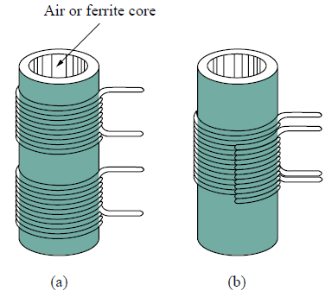
If the entire flux produced by one coil links another coil, then k = 1
and we have 100 percent coupling, or the coils are said to be perfectly coupled.
For k < 0.5, coils are said to be loosely coupled;
For k > 0.5, they are said to be tightly coupled.
We expect k to depend on the closeness of the two coils, their core, their orientation, and their windings.

Slide 22


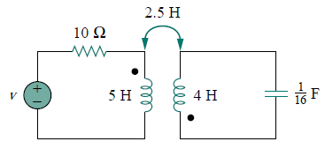



Slide 23
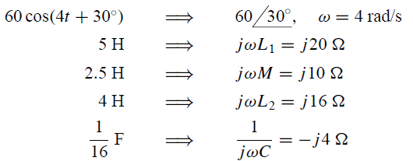
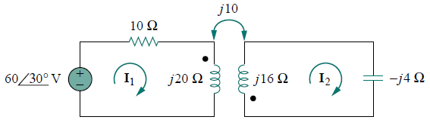









Slide 24
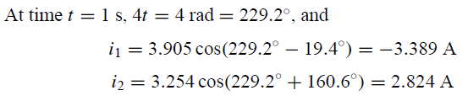
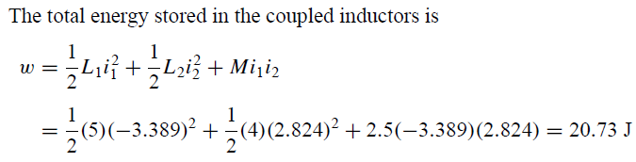

Slide 25


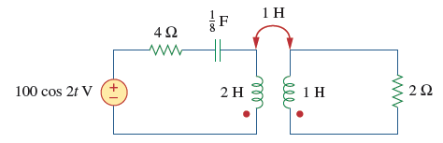

Slide 28
Coefficient of coupling k
where 0 ≤ k ≤ 1

Slide 29
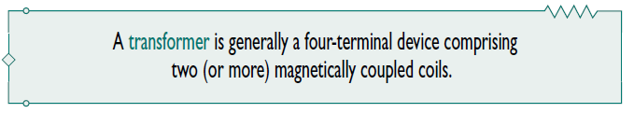
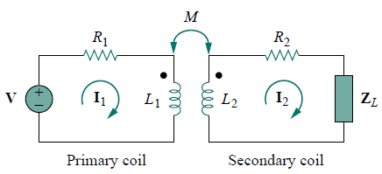
10.4 LINEAR TRANSFORMERS
Here we introduce the transformer as a new circuit element.
A transformer is a magnetic device that takes advantage of the phenomenon of mutual inductance.

Slide 30



We would like to obtain the input impedance Zin as seen from the source, because Zin governs the behavior of the primary circuit. Applying KVL to the two meshes in Fig. 13.19 gives
Primary impedance
Reflected impedance ZR

Slide 31
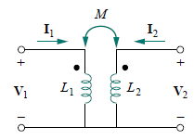
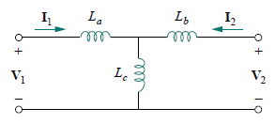
The little bit of experience gained in Sections 13.2 and 13.3 in analyzing magnetically coupled circuits is enough to convince anyone that analyzing these circuits is not as easy as circuits in previous chapters. For this reason, it is sometimes convenient to replace a magnetically coupled circuit by an equivalent circuit with no magnetic coupling.
We want to replace the linear transformer in Fig. 13.19 by an equivalent T or Ⅱ circuit, a circuit that would have no mutual inductance. Ignore the resistances of the coils and assume that the coils have a common ground as shown in Fig. 13.21.

Slide 32




Slide 33
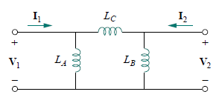
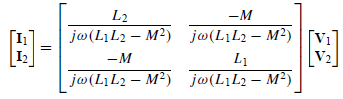
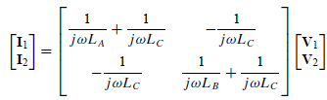
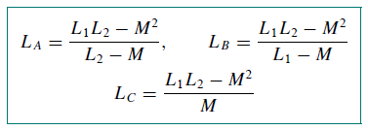

Slide 34


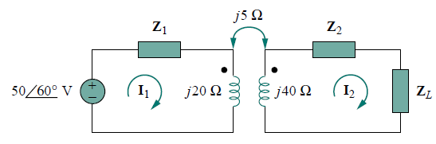




Slide 35
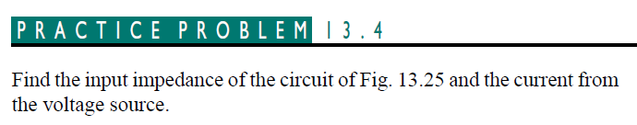
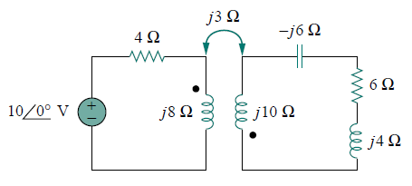


Slide 36
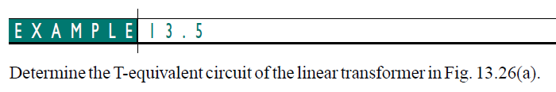
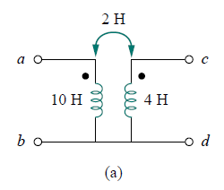
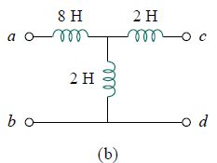


Slide 37


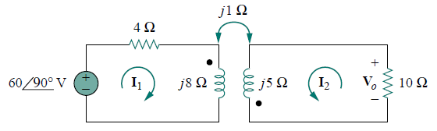
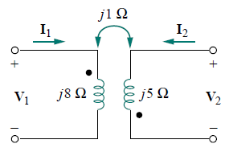
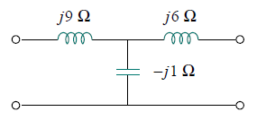


Slide 38
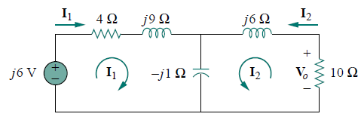

Slide 39






Slide 40
10.5 IDEAL TRANSFORMERS
An ideal transformer is one with perfect coupling (k = 1). It consists of two (or more) coils with a large number of turns wound on a common core of high permeability. Because of this high permeability of the core, the flux links all the turns of both coils, thereby resulting in a perfect coupling.
A transformer is said to be ideal if it has the following properties:
1. Coils have very large reactances (L1, L2, M →∞).
2. Coupling coefficient is equal to unity (k = 1).
3. Primary and secondary coils are lossless (R1 = 0 = R2).

Slide 41
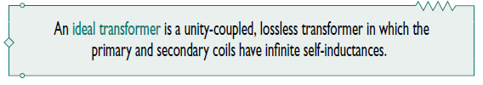


The vertical lines between the coils indicate an iron core as distinct from the air core used in linear transformers. The primary winding has N1 turns; the secondary winding has N2 turns.

Slide 42








When a sinusoidal voltage is applied to the primary winding as
shown in above Fig, the same magnetic flux φ goes through both windings.
n is the turns ratio or transformation ratio

Slide 43


When n = 1, we generally call the transformer an isolation transformer.
If n > 1, we have a step-up transformer, as the voltage is increased from primary to secondary (V2 > V1).
On the other hand, if n < 1, the transformer is a step-down transformer, since the voltage is decreased from primary to secondary (V2 < V1).

Slide 44




1. If V1 and V2 are both positive or both negative at the dotted terminals, use +n in Eq. Otherwise, use −n.
2. If I1 and I2 both enter into or both leave the dotted terminals, use −n in Eq. Otherwise, use +n.

Slide 45




Slide 46





Slide 47







Slide 48




Slide 49










Slide 50



13.6 IDEAL AUTOTRANSFORMERS
Unlike the conventional two-winding transformer we have considered so far, an autotransformer has a single continuous winding with a connection point called a tap between the primary and secondary sides.
The tap is often adjustable so as to provide the desired turns ratio for stepping up or stepping down the voltage. This way, a variable voltage is provided to the load connected to the autotransformer.

Slide 51





A major difference between conventional transformers and autotransformers is that the primary and secondary sides of the autotransformer are not only coupled magnetically but also coupled conductively. The autotransformer can be used in place of a conventional transformer when electrical isolation is not required.

Slide 52







Slide 53





Slide 54
Summary and Review
Mutual inductance describes the voltage induced at the ends of a coil due to the magnetic field generated by a second coil.
The dot convention allows a sign to be assigned to the mutual inductance term.
According to the dot convention, a current entering the dotted terminal of one coil produces an open-circuit voltage with a positive voltage reference at the dotted terminal of the second coil.
The total energy stored in a pair of coupled coils has three separate terms: the energy stored in each self-inductance (1/2Li²), and the energy stored in the mutual inductance (Mi₁i₂).

Slide 55
A linear transformer consists of two coupled coils: the primary winding and the secondary winding.
The coupling coefficient is restricted to values between 0 and 1.
Ideal transformer is a useful approximation for practical iron-core transformers. The coupling coefficient is taken to be unity, and the inductance values are assumed to be infinite.

Slide 56
Assignment (page 599)
Problems 13.7, 13.15, 13.33, 13.41,
13.53, 13.68.

Slide 57





Slide 58



